Slide 1
Enterprise Java Beans
Day 16,17

Slide 2
Lesson 1

Slide 3
Objectives
  In this lesson, you will learn about:
    The features of Enterprise JavaBeans
    Various components of EJB architecture
    Roles and responsibilities provided by EJB specification
    Different types of Enterprise JavaBeans
    Components of Enterprise JavaBeans

Slide 4
Enterprise JavaBeans
  Overview of EJB
    EJB is a server-side component architecture that simplifies the process of building enterprise-level, distributed applications in Java.
    EJB components are deployed in EJB containers of J2EE-compliant application servers, such as J2EE 1.4, Weblogic, and JBoss.
    Characteristics of EJB:
      Hides server-side system level issues from developers.
      Defines a standard component architecture that enables you to build distributed object-oriented business applications.
      Facilitates creating enterprise-level applications by allowing easy integrating with other EJB components as well as with other components, such as servlets, Java Server Pages (JSP), and Java Beans.
      Enables you to create components and applications that are reusable across various J2EE-compliant servers.

Slide 5
Enterprise JavaBeans (Contd.)
      The server-side components deployed on the application servers can be implemented using various technologies, such as EJB and Microsoft’s COM/DCOM.
      Enterprise JavaBeans are different from JavaBeans, another similarly named Sun Microsystems component based technology.
      Examples of real-life applications where you can use the EJB component architecture are:
        Online share trading application
        Online reservation application
        Online catalog application
        Online library application

Slide 6
Enterprise JavaBeans (Contd.)
  EJB in J2EE Architecture
    The J2EE platform uses an N-tiered application model.
      Client tier: Controls the interaction of the application with the user. The clients of this tier can be a browser client, a Java client, applets, or midlets.
      Web tier: Contains J2EE Web components, such as servlets and Java Server Pages(JSP) to enable communication between Web clients.
      Enterprise JavaBeans tier: Contains EJB components to implement the business logic of an application.
      Enterprise Information System (EIS) tier: Contains the information infrastructure of the application. The EIS tier can contain relational databases, legacy databases, and Enterprise Resource Planning (ERP) systems.

Slide 7
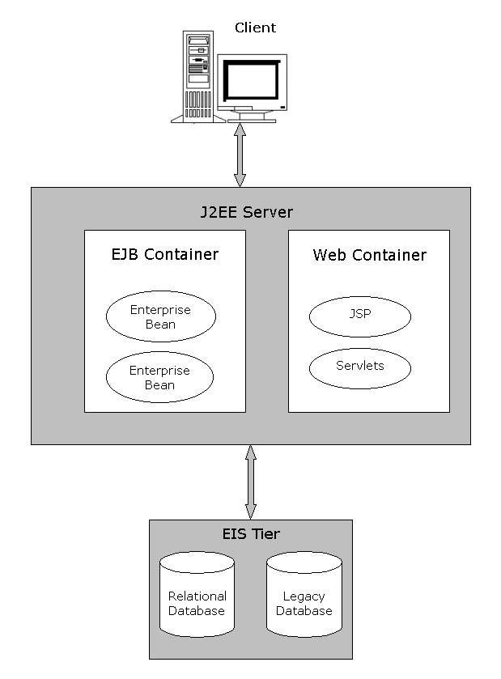
Enterprise JavaBeans (Contd.)
  Architecture of a J2EE application

Slide 8
Enterprise JavaBeans (Contd.)
    The J2EE server consists of containers to provide the runtime environment for different J2EE components.
    The EJB container stores the enterprise beans that implement the business logic of enterprise-level applications.
    EJB container provides various services:
      Persistence: EJB container manages the persistence of data for enterprise beans that are declared as Container Managed Persistence (CMP).
      Transaction management: EJB container manages the transactions for different enterprise beans of an EJB application. A transaction is a set of operations that is executed as a single unit.
      Security: EJB container provides security by allowing only authorized clients to access enterprise beans.

Slide 9
Enterprise JavaBeans (Contd.)
    Life cycle management: EJB container manages the life cycle of an enterprise bean and is responsible for changing the state of an enterprise bean as per client requests.
    Database connection pooling: EJB container creates a pool of database connections and allocates these connections to the enterprise bean as and when required.
    Remote client connectivity: EJB container allows clients at remote locations to access methods of an enterprise bean stored in the J2EE Server.

Slide 10
Enterprise JavaBeans (Contd.)
    The EJB container is also responsible for providing several Application Programming Interface (API) to support the running and deployment of an EJB.
    Various APIs provided by the EJB container are:
      Java Platform, Standard Edition, (J2SE) API
      EJB Standard Extension
      JDBC Standard Extension
      JNDI Standard Extension
      JMS Standard Extension
      JavaMail Standard Extension (for sending mail only)
      JAXP
      JTA Standard Extension (Only UserTransaction interface)

Slide 11
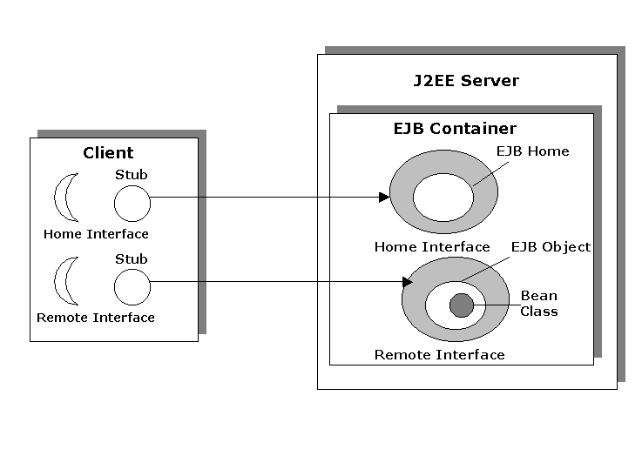
Enterprise JavaBeans (Contd.)
    EJB Architecture

Slide 12
Enterprise JavaBeans (Contd.)
  Various components of EJB architecture are:
    EJB Container: Provides the runtime environment for the EJB components and services, such as life cycle management, connection pooling, and security.
    EJB Component: Java classes that follow the EJB specification to implement the business logic of an application. EJB components are deployed in EJB container and are accessed using the remote and home interfaces of an enterprise bean.
    EJB Object: EJB container generates an EJB object, when a client needs to access an instance of the enterprise bean. The EJB object acts as an interface between the client and bean instances.
    Home Object: Home objects are generated by EJB container. Clients access EJB objects that are stored at different Java Virtual Machines (JVM), using the home object.

Slide 13
Enterprise JavaBeans (Contd.)
  EJB Roles and Responsibilities
    Bean provider
    Application assembler
    EJB deployer
    EJB server provider
    EJB container provider
    System administrator
  The bean provider is responsible for building the EJB components or enterprise beans by creating Java class files for them. After creating Java class files, the bean provider packages them into ejb-jar files.
  The application assembler is responsible for assembling different EJB components in order to build a complete application.

Slide 14
Enterprise JavaBeans (Contd.)
    Responsibilities of the application assembler are:
      Analyzing a business problem and assembling EJB components accordingly to solve the problem.
      Building new EJB components.
      Writing the integration code required to associate the EJB components built by different bean providers.
    The EJB deployer is responsible for deploying an assembled application in an application server. The EJB deployer is also responsible for customizing enterprise beans.
    The EJB server provider is responsible for providing EJB server, which manages client access to an application in a distributed environment. The EJB server provides a run-time environment, which conforms to the EJB specification.
    The EJB container provider is responsible for developing a container that is secure, scalable, and transaction-enabled.

Slide 15
Enterprise JavaBeans (Contd.)
    The EJB container provider’s responsibilities are:
      Providing the deployment tools that are required by the deployer for deploying EJB components.
      Providing run-time support for beans that are deployed on EJB server. Run-time support includes managing transactions, distributing network resources between clients, and managing scalability of resources.
    The system administrator is responsible for managing and running an EJB application.
    The system administrator’s responsibilities are:
      Configuring and managing the network infrastructure of an EJB application.
      Managing the working of EJB server and EJB container.
      Monitoring the working of deployed EJB applications.

Slide 16
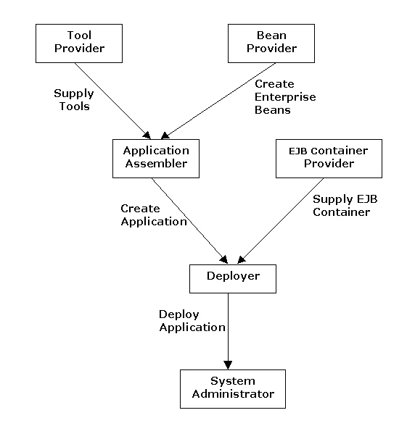
Enterprise JavaBeans (Contd.)
    Various EJB roles and their interaction

Slide 17
Enterprise JavaBeans (Contd.)
  Types of EJB
    The EJB specification defines different types of enterprise beans to implement the business logic of an EJB application.
    The three types of beans are:
      Session beans
      Entity beans
      Message-driven beans

Slide 18
Enterprise JavaBeans (Contd.)
    Session beans:
      Implement the business processes in an application.
      Have the following types:
        Stateless: This type of session bean does not maintain the state of the client across various method calls.
        Stateful: This type of session bean maintains the state of a client across various method calls by the same client.

Slide 19
Enterprise JavaBeans(Contd.)
    Entity beans:
      Are Java components that can access and store persistent data in a relational database.
      Implement business objects in an EJB application.
      Have the following types:
        Bean-Managed Persistence (BMP): This bean enables you to manage database queries and connectivity issues. You need to write the codes for establishing database connectivity and querying database tables in the bean class file.
        Container-Managed Persistence (CMP): This bean enables EJB container to manage database queries and connectivity issues. Database connectivity is implicitly managed by EJB container.

Slide 20
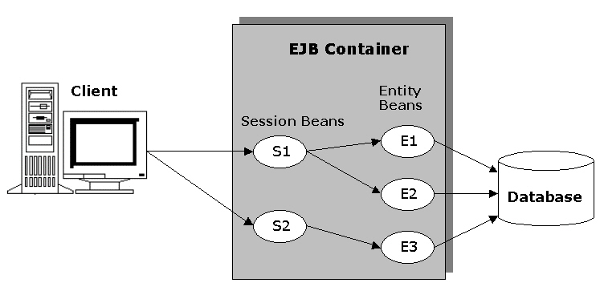
Enterprise JavaBeans(Contd.)
  Interaction between session beans and entity beans in an EJB application:

Slide 21
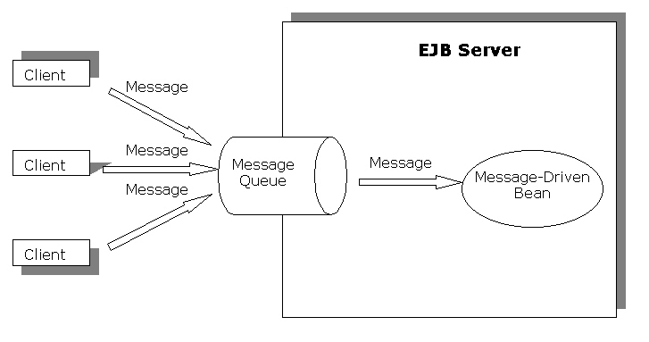
Enterprise JavaBeans(Contd.)
  Message-driven beans:
    Implement the business logic that requires asynchronous messaging between components of an EJB application.
    Allow processing of Java Messaging Service (JMS) messages in the J2EE architecture.
    Can send and receive messages asynchronously thereby speeding up the process of messaging in J2EE.
  Use of message-driven beans in EJB applications is as follows:

Slide 22
EJB Components and Programming Restrictions
  Components of an enterprise bean are:
    Enterprise Bean Class: It consists of various methods that implement the business logic of an enterprise bean. The bean class also implements life cycle methods of an enterprise bean.
    EJB Object: It is a container-generated object that interacts with the client, on behalf of EJB container, to provide services, such as transaction control, security, and persistence.
    Remote Interface: It declares methods, which an enterprise bean provides to clients in order to enable them to perform business operations.
    Home Object: It is a container-generated object that provides methods to create, find, and remove EJB objects. This object implements methods of the home interface.

Slide 23
EJB Components and Programming Restrictions (Contd.)
      Home Interface: It declares the various life cycle methods that involve operations, such as creating, finding, and removing enterprise beans.
      Local Interfaces: These are used when the enterprise bean and the client are stored in the same JVM.

Slide 24
EJB Components and Programming Restrictions (Contd.)
  The Enterprise Bean Class
    The enterprise bean class of an EJB application is a Java class that contains the methods to implement the business logic of an EJB application.
    To create an enterprise bean class for a session bean, you need to implement the javax.ejb.SessionBean interface.
    You need to implement the javax.ejb.EntityBean and javax.ejb.MessageDrivenBean interfaces for creating the enterprise bean class for entity and message-driven beans, respectively.

Slide 25
EJB Components and Programming Restrictions (Contd.)
  The Remote Interface
    The remote interface declares the business methods of an enterprise bean, which can be invoked by a client that is stored at a remote JVM.
    The rules to create a remote interface file are:
      It should extend the javax.EJBObject interface.
      It should contain a declaration of all the methods that are accessible to the clients.
      All the methods that is remotely accessible to client must throw an exception of type java.rmi.RemoteException. This type of exception is raised when a network connection failure occurs.

Slide 26
EJB Components and Programming Restrictions (Contd.)
    The remote interface inherits following methods from the javax.ejb.EJBObject interface:
        getEJBHome()
        getPrimaryKey()
        remove()
        getHandle()
        isIdentical()

Slide 27
EJB Components and Programming Restrictions (Contd.)
  EJB Object:
    Is a container-generated Java class file containing all the business methods that an enterprise bean provides to its clients.
    Provides services, such as transaction support, security, resource management, persistence, and remote accessibility.
    Implements the intermediate services before forwarding the client call to the enterprise bean instance for servicing client request.

Slide 28
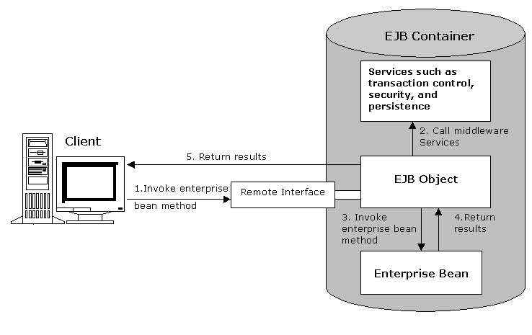
EJB Components and Programming Restrictions (Contd.)
    EJB object acts as an intermediate between a client and an enterprise bean instance as shown below:

Slide 29
EJB Components and Programming Restrictions (Contd.)
  The Home Interface:
    Involves declaring the various life cycle methods of an enterprise bean.
    Should import the following packages:
      java.io.Serializable
      java.rmi.RemoteException
      javax.ejb.CreateException
      javax.ejb.EJBHome
    Should extend the EJBHome interface and its name should not be a keyword in Java.
    Should contain a create() method whose return type is the same as the type of the remote interface of the enterprise bean. The create() method is responsible for creating a new instance of enterprise bean.

Slide 30
EJB Components and Programming Restrictions (Contd.)
    Inherits methods from the javax.ejb.EJBHome interface
      getEJBMetaData()
      getHomeHandle()
      remove()

Slide 31
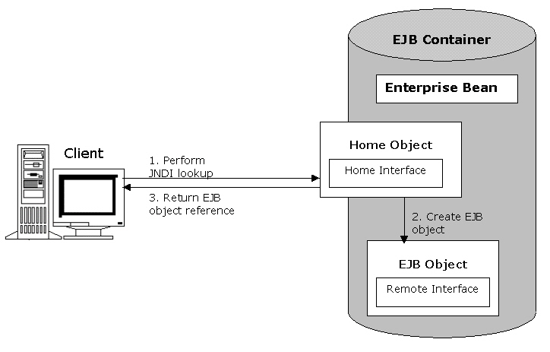
EJB Components and Programming Restrictions (Contd.)
  EJB Home interface is used to create an EJB object:

Slide 32
EJB Components and Programming Restrictions (Contd.)
  The Home Object:
    Is a container-generated object responsible for instantiating and managing EJB objects.
    Enables clients to instantiate an EJB object that is stored in a remote JVM.
    Performs the following functions:
      Creating EJB objects
      Searching for EJB objects
      Removing EJB objects

Slide 33
EJB Components and Programming Restrictions (Contd.)
  The Local Interfaces:
    Are created when the client and the enterprise bean are stored on the same JVM.
    Are of two types:
      local interface
      local home interface

Slide 34
EJB Components and Programming Restrictions (Contd.)
    The advantages of using local interfaces
      Improved performance: The time required in calling methods of one EJB component from another decreases, improving the overall performance of the EJB application.
      Sharing of data: Data can be shared between the calling component and the enterprise bean because the arguments to the methods in a local and local home interface are passed by reference.

Slide 35
EJB Components and Programming Restrictions (Contd.)
    Creating the Local Interface
      Local interface:
        Contains the declaration of the methods, which are accessible to the clients.
        Is created by extending the javax.ejb.EJBLocalObject interface.

Slide 36
EJB Components and Programming Restrictions (Contd.)
  Creating the Local Home Interface
    Local home interface:
      Contains the same set of functions as the home interface.
      Is created by extending the javax.ejb.EJBLocalHome interface.

Slide 37
EJB Components and Programming Restrictions (Contd.)
  The Deployment Descriptor:
    Is an eXtensible Markup Language (XML) file with the name ejb-jar.xml that contains information about middleware services, such as transaction and security required by EJB components.
    Provides EJB Container information regarding the type of enterprise bean and the names of the remote interface, home interface, and the bean class files.
    Contains various tags, such as <ejb-name> and <ejb-class>. The type and number of tags used varies according to the type of enterprise beans that a deployment descriptor describes.

Slide 38
EJB Components and Programming Restrictions (Contd.)
    Commonly used tags used in a deployment descriptor:
      <ejb-jar>: Is the basic tag of an enterprise bean. All other tags of a deployment descriptor are specified inside this tag.
      <enterprise-beans>: Contains the declarations of all the enterprise beans that the deployment descriptor describes.
      <ejb-name>: Specifies the name of the enterprise bean.
      <home>: Specifies the name of the home interface of an enterprise bean.
      <remote>: Specifies the name of the remote interface of an enterprise bean.
      <ejb-class>: Specifies the name of an enterprise bean class.

Slide 39
EJB Components and Programming Restrictions (Contd.)
    Packaging EJB Components
      An EJB application and its various components are deployed and distributed in the form of packages.
      The process of packaging:
        Enables you to handle and use multiple files related to one EJB component, simultaneously.
        Saves disk space by compressing files.
      The EJB components of an EJB application are packaged into Java Archive (JAR) files and the Web components are packaged into Web Archive (WAR) files.

Slide 40
EJB Components and Programming Restrictions (Contd.)
      The components of an enterprise bean are packaged as an ejb-jar file.
      The various component files that are packaged into an ejb-jar file are:
        Bean class file
        Remote interface file
        Local interface file
        Local home interface file
        Home interface file
        Deployment descriptor file

Slide 41
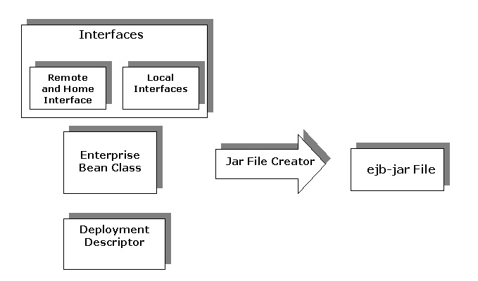
EJB Components and Programming Restrictions (Contd.)
    Packaging an enterprise bean

Slide 42
EJB Components and Programming Restrictions (Contd.)
  Programming Restrictions in EJB are:
    The EJB specification defines certain programming restrictions to prevent the programming of system-level services by programmers.
    The programming practices that should be avoided are:
      Using the java.io package to access files and directories.
      Using Abstract Window Toolkit (AWT) to display data and enter information using keyboard.
      Performing thread management operations, such as starting and stopping threads.
      Performing socket operations, such as listening to and accepting socket connections or using a socket for multicast.
      Performing thread synchronization.
      Setting a socket factory used by Socket and ServerSocket, or the stream handler socket factory.

Slide 43
EJB Components and Programming Restrictions (Contd.)
      Loading native libraries.
      Performing class loader operations, such as creating, obtaining, and setting the class loader.
      Reading or writing a file descriptor directly.
      Defining a class in a package.
      Accessing and modifying the various security configuration objects, such as Policy, Security, Provider, Signer, and Identity.
      Using the subclass and object substitution features of Java serialization protocol.
      Passing this as an argument or method result.
      Obtaining security policy information for a particular code source.
      Performing certain security-related operations, such as setting and creating security manager.

Slide 44
Summary
In this lesson, you learned:
  EJB is the server-side component architecture that enables you to develop the distributed enterprise-level applications in Java.
  An EJB application consists of three components: J2EE server, client, and database. The J2EE server contains deployed EJB components that are also known as enterprise beans.
  The EJB tier consists of various components, such as EJB server, EJB container, stubs, skeletons, and the remote and home interfaces.
  EJB container is responsible for providing system-level services to enterprise beans. System level services include network connections, transaction control security, and run time services.
  Enterprise beans are of three types: session beans, entity beans, and message-driven beans.
  An enterprise bean consists of various components, such as remote interface, home interface, and bean class file.

Slide 45
Summary (Contd.)
  EJB container generates two objects, EJB home object and EJB object, which facilitate the interaction between a client and an enterprise bean.
  Local interfaces enable you to make the calling process between two components of an EJB application faster. The process is faster because both the components are stored at the same JVM and the calls do not have to go through stubs, skeletons, and network calls.
  The deployment descriptor in EJB is an XML file that specifies the features of an enterprise bean to EJB container.
  EJB components are distributed and deployed in the form of packages. A package stores the various files that constitute the EJB component as a single file.
  The EJB specification defines the certain programming restrictions required for preventing the programming of system level services by programmers.

Slide 46
Lesson 2
Session beans

Slide 47
Objectives
  In this lesson, you will learn to:
    Describe the characteristics of session beans
    Identify different types of session beans
    Explain the life cycle of stateless session beans
    Create and deploy stateless session beans
    Create applications using stateless session beans

Slide 48
Pre-assessment Questions
  Which component of the enterprise bean interacts with the client, on behalf of EJB Container, to provide services, such as transaction control, security, and persistence?
    Enterprise Bean Class
    Remote Interface
    Home Interface
    EJB Object
  Who has the responsibility of packaging the Java class files into the ejb-jar files in EJB specification?
    Bean provider
    Application assembler
    EJB container provider
    EJB server provider

Slide 49
Pre-assessment Questions (Contd.)
  Who has the responsibility in the EJB specification of analyzing a business problem and assembling EJB components accordingly to solve the problem?
    EJB deployer
    EJB server provider
    Bean provider
    Application assembler
  Which bean enables EJB container to manage database queries and connectivity issues?
    Message-driven bean
    BMP entity bean
    CMP entity bean
    Session bean

Slide 50
Pre-assessment Questions (Contd.)
  Which bean implements the business logic that requires asynchronous messaging between components of an EJB application?
    Message-driven bean
    BMP entity bean
    CMP entity bean
    Session bean

Slide 51
Solutions to Pre-assessment Questions
  d. EJB Object
  a. Bean provider
  d. Application assembler
  c. CMP entity bean
  a. Message-driven bean

Slide 52
Overview of Session Beans
  Session beans:
    Are are used to perform the business functions of the enterprise applications.
    Have the following characteristics:
      They are not permanent in nature.
      They implement conversational state between the client and the J2EE server.
      They service a single client request at a time.
      They enable you to access data stored in a database.
    Have the following types:
      Stateless session bean
      Stateful session bean

Slide 53
Overview of Session Beans (Contd.)
    Characteristics of a Stateless Session Bean:
      It executes business operations without maintaining client state.
      It stores the client state in instance variables only for the period during which a method of the stateless session bean is executed.
      It handles a client request that is processed by a single session bean method.
      It is a lightweight component. A stateless session bean does not contain complex data structures because it does not store client state.
      It contains methods that perform business functions, which are not
      client-specific.
      It improves the scalability of an application because a smaller number of stateless session bean instances can service a larger number of client requests.

Slide 54
Overview of Session Beans (Contd.)
    Characteristics of a Stateful Session Bean are:
      It maintains client state while executing different business operations in enterprise applications.
      It reduces application scalability because EJB container needs to manage a large number of stateful session bean instances to service multiple client requests.
      In enterprise applications, the number of stateful session bean instances is equal to the number of clients. This is because each stateful session bean instance stores the state for a particular client.

Slide 55
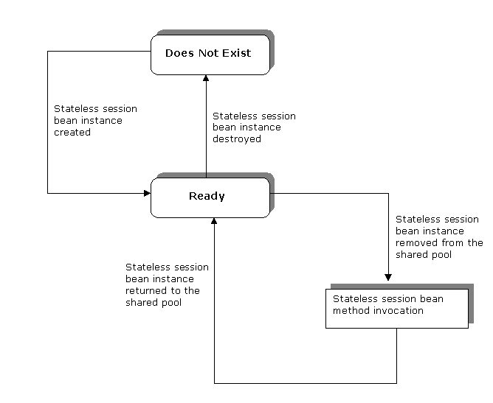
Stateless Session Bean
  Life Cycle of a Stateless Session Bean consist of the following stages:
    Ready Stage
    Does Not Exist Stage

Slide 56
Stateless Session Bean (Contd.)
    The Ready Stage
      At the beginning of its life cycle, a stateless session bean is in the Ready stage.
      In ready stage, a stateless session bean instance remains in the shared pool ready to service client requests. A shared pool refers to a pool of stateless session bean instances that is maintained by the EJB container to handle client requests.
      A new stateless session bean instance enters the shared pool when created by EJB container.
      If the number of stateless session bean instances is insufficient to service client requests, EJB container creates new stateless session bean instances and puts them in the shared pool.

Slide 57
Stateless Session Bean (Contd.)
    Steps performed by EJB Container to create a new stateless session bean instance are:
      1. Invokes the newInstance() method, which instantiates a new stateless session bean instance by calling the stateless session bean’s default constructor.
      2. Invokes the setSessionContext() method to associate the bean’s instance with information about the environment in which bean instance will execute.
      3. Invokes the ejbCreate() method defined in the stateless session bean class. The ejbCreate() method for a stateless session bean contains no arguments because a stateless session bean does not store client-specific information.

Slide 58
Stateless Session Bean (Contd.)
    The Does Not Exist Stage
      At the end of its life cycle, a stateless session bean is in the Does Not Exist stage.
      In this stage, a stateless session bean is permanently removed from the shared pool.

Slide 59
Stateless Session Bean (Contd.)
  EJB Session Context
    EJB container contains detailed information of every enterprise bean instance.
    The information includes reference of bean home interface, client’s security permissions, and transactions currently associated with the bean instance. All this information is stored in the EJB context object.
    An enterprise bean uses the EJB context object to access a bean’s status, such as its transaction and security information.
    There is a different EJB context object corresponding to each type of enterprise bean.
    The EJB session context object enables session beans to interact with EJB container to perform the following functions:
      Retrieve the reference to the home objects
      Retrieve transaction attributes
      Set transaction attributes

Slide 60
Stateless Session Bean (Contd.)
    The javax.ejb package provides the SessionContext interface that enables you to access the EJB session context object.
    The setSessionContext() method returns information about a stateless session bean’s environment using the methods declared in the SessionContext interface:
      EJBObject getEJBObject(): Returns the reference to the EJB object of the session bean in which getEJBObject() method is called.
      EJBLocalObject getEJBLocalObject(): Returns the reference to the local EJB object of the session bean in which getEJBLocalObject() method is called.
      EJBHome getEJBHome(): Returns the reference to the home object of the session bean in which getEJBHome() method is called.
      EJBLocalHome getEJBLocalHome(): Returns the local home object of the session bean in which the getEJBLocalHome() method is called.

Slide 61
Creating Stateless Session Beans
  Using Java Files to Create a Stateless Session Bean
    You need to define the following three Java files in order to create a stateless session bean:
      Stateless session bean home interface: Contains methods to create and remove stateless session bean instances.
      Stateless session bean remote interface: Contains the business methods implemented in the stateless session bean class.
      Stateless session bean class: Implements stateless session bean life cycle methods and business methods defined in the stateless session bean remote interface.

Slide 62
Creating Stateless Session Beans (Contd.)
    Creating a Stateless Session Bean Home Interface
      The home interface declares the various life cycle methods of a stateless session bean, such as remove() and create().
      The EJB container generates the home objects by extending the home interface.
      Clients use stateless session bean home objects to create and access an EJB object.

Slide 63
Creating Stateless Session Beans (Contd.)
    You can create two types of stateless session bean home interfaces Bean provider:
      Remote home interface
      Local home interface
    You need to extend the EJBHome interface of the javax.ejb package, in order to create a stateless session bean remote home interface.
    The EJBHome interface defines the following methods that are invoked by clients to manage a stateless session bean remotely:
      EJBMetaData getEJBMetaData()
      HomeHandle getHomeHandle()
      void remove(Handle hd)
    A stateless session bean home interface declares the create() method.

Slide 64
Creating Stateless Session Beans (Contd.)
    The create() method of the stateless session bean remote home interface throws the javax.ejb.CreateException and javax.ejb.RemoteException exceptions.
    The return type of the create() method is of the stateless session bean remote interface type.
    The remote home interface needs to fulfill the following requirements:
      It needs to extend the javax.ejb.EJBHome interface.
      It needs to declare one or more create() methods. In case of stateless session beans only one create() method is required.
      It needs to declare create() methods that correspond to the ejbCreate() methods in the bean class and return type of the create() methods should be of the type remote interface.
      It needs to declare the throws clause of create() method as javax.ejb.CreateException and java.rmi.RemoteException.

Slide 65
Creating Stateless Session Beans (Contd.)
    You need to extend the EJBLocalHome interface to create a stateless session bean local home interface.
    You need to declare the create() method in a stateless session bean local home interface.
    The create() method of a stateless session bean local home interface throws the javax.ejb.CreateException and javax.ejb.EJBException exceptions.
    The return type of the create() method is stateless session bean local interface type.

Slide 66
Creating Stateless Session Beans (Contd.)
    The local home interface to fulfill the following requirements:
      It should not declare methods, which throw exceptions of the RemoteException type.
      It can have super interfaces.
      It should declare one or more create() methods that correspond to ejbCreate()methods in the session bean class. The return type of each create() method should be of the type local interface.
      For each create() method, It should declare the same exceptions that are declared in throws clause of corresponding ejbCreate() method in the bean class.
      It should declare the javax.ejb.CreateException in throws clause of each create() method.

Slide 67
Creating Stateless Session Beans (Contd.)
    Creating a Stateless Session Bean Remote Interface
      A stateless session bean remote interface declares the business methods of the bean that client can call. These business methods are implemented in the stateless session bean class.
      You need to extend the EJBObject interface stored in the javax.ejb package to create a stateless session bean remote interface.
      The methods in the EJBObject interface are declared as abstract and their implementation can be provided in the remote interface.
      Various methods declared in the EJBObject interface are:
        EJBHome getEJBHome()
        Handle getHandle()
        boolean isIdentical(EJBObject obj)
        void remove()

Slide 68
Creating Stateless Session Beans (Contd.)
    You can also create a local interface of a stateless session bean that declares the business method that the local clients can call.
    You need to declare the business methods in a stateless session bean local interface in the same way as in a stateless session bean remote interface.
    The local interface needs to fulfill the following requirements:
      It needs to extend the javax.ejb.EJBLocalHome interface.
      It should not declare the business methods with exception, java.rmi.RemoteException, in their throws clause.
      It should only declare the business methods, which are implemented in the bean class file of the stateless session bean.
      It can have super interfaces that fulfill the RMI/IIOP requirements.

Slide 69
Creating Stateless Session Beans (Contd.)
    Creating Stateless Session Bean Class
      The stateless session bean class:
        Implements the life cycle methods used by EJB container to control the life cycle of a stateless session bean.
        Implements the business methods declared in the stateless session bean remote interface.
        Is created by implementing the SessionBean interface of the javax.ejb package.

Slide 70
Creating Stateless Session Beans (Contd.)
      The SessionBean interface contains the following methods to control the life cycle of a stateless session bean:
        ejbActivate()
        ejbPassivate()
        ejbRemove()
        setSessionContext(SessionContext ctx)

Slide 71
Creating Stateless Session Beans (Contd.)
    A stateless session bean class declares a constructor without any arguments. EJB container invokes this constructor to create a stateless session bean instance.
    EJB container does not activate or passivate a stateless session bean instance, therefore, you should provide empty implementation for ejbActivate() and ejbPassivate() methods in the stateless session bean class.
    The bean class needs to fulfill the following requirements:
      It should implement the javax.ejb.SessionBean interface.
      It should be declared as public and not as final or abstract.
      It should declare a public constructor that accepts no arguments.
      It should not define finalize() method.

Slide 72
Creating Stateless Session Beans (Contd.)
      It should implement business methods that need to be be declared as public and not as final or static. These business methods can throw application exceptions.
      It can have super classes and super interfaces.
      It should implement one or more ejbCreate() methods that fulfill the criteria:
        Should be declared as public and not as final or static.
        Should have void return type.
        Should have RMI/IIOP compliant arguments and return values.

Slide 73
Creating Stateless Session Beans (Contd.)
  Compiling and Deploying a Stateless Session Bean
    After creating the Java files for a stateless session bean, you need to set the location of the j2ee.jar file that exists in the Sun/Appserver/lib directory in the system classpath. Command used to set the location of the j2ee.jar file is:
      set classpath=.c:/Sun/Appserver/lib/j2ee.jar
    After you set the classpath, you need compile all the Java files using the javac compiler. Command used to compile the Java files is:
      javac <file_name>
    The compiled Java class files of the stateless session bean are deployed in the J2EE 1.4 application server using the deploytool utility.

Slide 74
Creating Stateless Session Beans (Contd.)
    The Enterprise Bean Wizard of the deploytool utility is used to deploy a stateless session bean. The deploytool utility packages the compiled Java class files in a JAR file.
    The deploytool utility automatically generates the code of the deployment descriptor of a stateless session bean.

Slide 75
Creating Stateless Session Beans (Contd.)
  Accessing a Stateless Session Bean
    A client accesses a stateless session bean’s business methods using the references of its home and remote interfaces.
    A stateless session bean can be accessed by both Web and Application clients. The Web clients consist of Java Server Pages (JSP) and servlets where as the Application clients consist of standalone Java classes.
    Steps performed by a client to access a stateless session bean
      1. Locates a stateless session bean in the J2EE 1.4 Application Server.
      2. Retrieves references of stateless session bean home and remote interfaces.

Slide 76
Creating Stateless Session Beans (Contd.)
    Locating a Stateless Session Bean
      A client locates a stateless session bean in the J2EE 1.4 Application Server using the Java Naming Directory Interface (JNDI).
      To locate a stateless session bean, the client performs the following steps
        Creates an initial naming context using the InitialContext interface of JNDI.
        Locates the home object of the deployed stateless session bean using the lookup() method. This method returns the reference of the home object which is an implementation of the stateless session bean home interface.

Slide 77
Creating Stateless Session Beans (Contd.)
    Retrieving References of Stateless Session Bean Interfaces
      After locating the stateless session bean’s home object, a client retrieves the reference to the EJB object that is created by the EJB Container.
      Clients do not have direct access to a stateless session bean class. They can invoke a bean’s business methods using the reference of the EJB object which is an implementation of the stateless session bean remote interface.
      Clients use the narrow() method of the PortableRemoteObject interface to retrieve the reference of the EJB object.
      Local clients retrieve stateless session bean local home interface reference using the lookup() method of the InitialContext interface.

Slide 78
Creating Stateless Session Beans (Contd.)
      A client calls the create() method in the stateless session bean home interface to retrieve the reference of stateless session bean remote interface.

Slide 79
Implementing Stateless Session Beans
  Problem Statement
    Chris is developing an online banking application. This online application will enable customers to perform banking transactions and apply for loans. One of the modules in the application enables bank customers to calculate the loan interest for a specified time period. Chris needs to develop this module using appropriate enterprise beans.

Slide 80
Implementing Stateless Session Beans (Contd.)
  Solution
    To solve the above problem, perform the following tasks:
      1. Create the stateless session bean home interface.
      2. Create the stateless session bean remote interface.
      3. Create the stateless session bean class.
      4. Create the Web client HTML file.
      5. Create the Web client servlet.
      6. Package the stateless session bean.

Slide 81
Implementing Stateless Session Beans (Contd.)
      7. Package the Web client.
      8. Specify Web client’s enterprise bean reference.
      9. Deploy the application.
      10. Test the application.

Slide 82
Summary
In this lesson, you learned:
  Session beans are enterprise beans deployed in EJB container that perform business functions, on behalf of clients.
  In distributed enterprise applications, clients use the methods defined in the session beans to access remote services defined on the server-side.
  There are two types of session beans, stateful session beans and stateless session beans.
  A stateless session bean does not maintain client state across method calls. When the execution of a bean method completes, the client information is no longer retained.
  A stateful session bean maintains client state while executing business operations.
  A stateless session bean life cycle consists of two stages, Ready and Does Not Exist.

Slide 83
Summary (Contd.)
  To create a stateless session bean, you need to perform following tasks:
    Create a stateless session bean remote home or local home interface
    Create a stateless session bean remote or local interface
    Create a stateless session bean class.
  A stateless session bean client can access the bean by first locating the stateless session bean in the J2EE 1.4 server and then retrieving the remote and home interfaces of the stateless session bean. A client then calls the business methods of the remote interface to perform the business operations.

Slide 84
Stateful Session Bean

Slide 85
Objectives
  In this lesson, you will learn to:
    Identify stateful session beans
    Create stateful session beans
    Implement stateful session beans

Slide 86
Pre-assessment Questions
  Invoking the remove() method to remove instances of session bean will throw the _____________ exception.
    EJBException
    CreateException
    RemoteException
    RemoveException
  Which method of the EJBHome interface is invoked by the clients to manage a stateless session bean remotely?
    getEJBHome()
    getHomeHandle()
    getHandle()
    isIdentical()

Slide 87
Pre-assessment Questions (Contd.)
  What is the number of arguments passed to the create()method to create a stateless session bean instance?
    One
    Two
    Three
    Zero
  Which method of the PortableRemoteObject interface is used by the clients to retrieve the reference of a stateless session bean home interface?
    getHomeHandle()
    getEJBMetaData()
    narrow()
    getEJBHome()

Slide 88
Pre-assessment Questions (Contd.)
  Which method is used by the setSessionContext() method defined in the SessionContext interface to get the the local interface of a session bean?
    getEJBHome()
    getEJBLocalObject()
    getEJBObject()
    getEJBLocalHome()

Slide 89
Solutions to Pre-assessment Questions
  a. EJBException
  b. getHomeHandle()
  c. Zero
  c. narrow()
  b. getEJBLocalObject()

Slide 90
Overview Of Stateful Session Beans
    In an application, a stateful session bean maintains the state of a client.
    A client starts a conversation with a stateful session bean when it invokes the bean’s method in an EJB object.
    When the conversation ends, the conversational state is preserved and client-specific information regarding the conversation between the client and the bean is stored.
    When the client calls another method in the stateful session bean, the client may require to know the conversational state of the previous method call. A stateful session bean retains conversational state for individual clients across method calls.

Slide 91
Overview Of Stateful Session Beans
  Life Cycle of Stateful Session Beans
    EJB container:
      Controls the life cycle of a stateful session bean.
      Assigns one stateful session bean instance to serve a single client at a time. As a result, there should be as many stateful session bean instances in the pool as the number of clients.
      Cannot randomly destroy a stateful session bean instance because it stores the client state.
      Ensures that the client state stored in the instance variables of a bean is not required in processing the application, before destroying a stateful session bean instance,.

Slide 92
Overview Of Stateful Session Beans
(Contd.)
    The stages in the life cycle of a stateful session bean are:
      Ready: In this stage, a stateful session bean instance remains in the shared pool and services client requests.
      Passive: In this stage, a stateful session bean instance stores client state in secondary storage and stops servicing client requests.
      Does Not Exist: In this stage, a stateful session bean is permanently removed from the shared pool.

Slide 93
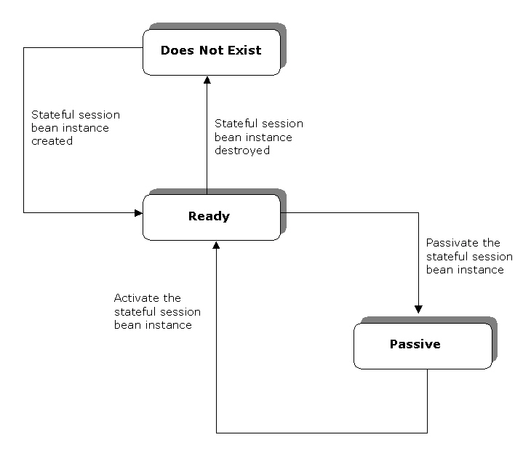
Overview Of Stateful Session Beans
(Contd.)
    The life cycle stages of a stateful session bean

Slide 94
Overview Of Stateful Session Beans
(Contd.)
    The Ready Stage
      At the beginning of its life cycle, a stateful session bean is in the Ready stage.
      A stateful session bean instance moves to the Ready stage in the following cases:
        When EJB container creates a new stateful session bean instance.
        When EJB container activates a passivated stateful session bean.
      EJB container creates new stateful session bean instances when there are insufficient stateful session bean instances in the shared pool to service client requests.

Slide 95
Overview Of Stateful Session Beans
(Contd.)
    To create a new stateful session bean instance, EJB container performs the following steps:
      EJB container invokes the:
        newInstance() method, which instantiates a new stateful session bean instance.
        setEntityContext() method to associate the stateful session bean instance with the bean context.
        ejbCreate() method of the stateful session bean class. You can pass arguments to the ejbCreate() method to initialize a new stateful session bean instance. A stateful session bean can have more than one ejbCreate() method, where each method has a different number and type of arguments.

Slide 96
Overview Of Stateful Session Beans
(Contd.)
      A stateful session bean instance can also reach the Ready stage, when EJB container activates a passivated stateful session bean by invoking the ejbActivate() method.
      The ejbActivate() method transfers a passivated stateful session bean’s client state to the stateful session bean instance variables.
      EJB container calls the ejbActivate() method to allow the bean to acquire the resources released by it during passivation.

Slide 97
Overview Of Stateful Session Beans
(Contd.)
    The Passive Stage
      A stateful session bean moves to the Passive stage in its life cycle when EJB container releases it from serving an idle client and returns the stateful session bean instance to the shared pool to service another client’s requests.
      Before passivation, EJB container saves the client state associated with the stateful session bean instance in a secondary storage device, such as hard disk in the server.
      EJB container calls the ejbPassivate() method before it passivates a session bean. This allows a stateful session bean to release its resources.

Slide 98
Overview Of Stateful Session Beans
(Contd.)
    The Does Not Exist Stage
      At the end of its life cycle, a stateful session bean instance moves to the Does Not Exist stage.
      A stateful session bean instance reaches this stage in the following cases:
        When EJB container invokes the ejbRemove() method.
        When the timeout of the bean instance lifecycle, specified by the bean developer, expires.

Slide 99
Overview Of Stateful Session Beans
(Contd.)
      EJB container destroys stateful session bean instances when the number of instances is greater than the number of active client requests.
      EJB container fails to invoke the ejbRemove() method in the following cases:
        When EJB container failure occurs.
        When a stateful session bean method execution throws a system exception.

Slide 100
Overview Of Stateful Session Beans
(Contd.)
  Activation and Passivation of Stateful Session Beans
    EJB container passivates and activates the stateful session bean instances in the shared pool to reduce the overhead of storing a large number of bean instances.
    EJB container stores the bean state of an idle bean instance in a secondary storage device. This process is called passivation.
    When the client of a passivated bean calls another bean method, the bean state is restored to a stateful session bean instance. This process is called activation.

Slide 101
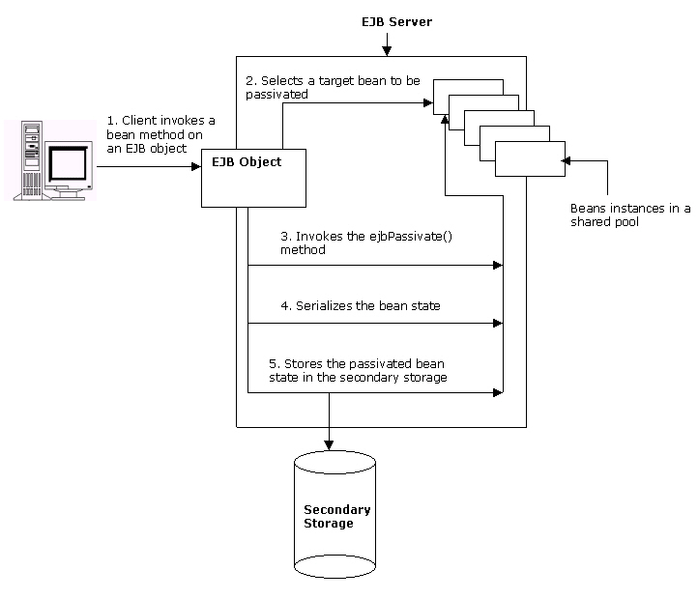
Overview Of Stateful Session Beans
(Contd.)
    The passivation of stateful session bean

Slide 102
Overview Of Stateful Session Beans
(Contd.)
    Stateful session beans preserve the references of the following interfaces, in addition to client-specific information during passivation:
      javax.ejb.EJBHome
      javax.ejb.EJBObject
      javax.jta.UserTransaction
      javax.naming.Context
      javax.ejb.EJBLocalHome
      javax.ejb.EJBLocalObject

Slide 103
Overview Of Stateful Session Beans
(Contd.)
    Various algorithms used to implement passivation are:
      Least Recently Used (LRU): Selects the stateful session bean instance which has been inactive for the longest duration. This is also known as eager passivation.
      Not Recently Used (NRU): Selects the stateful session bean instance which has become inactive recently.
      First In First Out (FIFO): Selects the stateful session bean instance which had entered the pool first and is inactive. This is also known as lazy passivation.
    Most EJB servers use just-in-time algorithm, according to this algorithm, a passivated bean is activated when a client request regarding this bean is made.

Slide 104
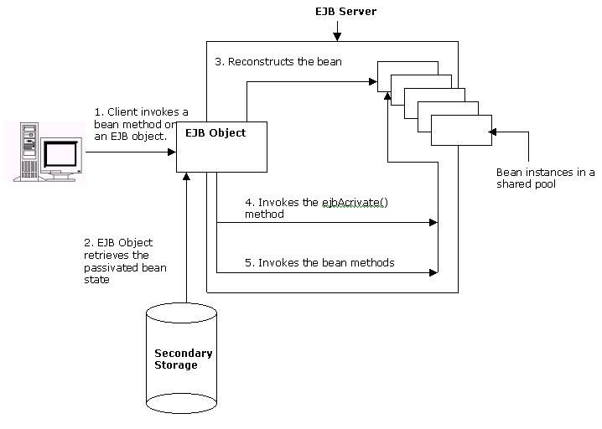
Overview Of Stateful Session Beans
(Contd.)
    The activation of a stateful session bean

Slide 105
Creating Stateful Session Beans
    You need to develop the bean interfaces and the bean class to create a stateful session bean.
    After creating the files, you need to compile them to generate the class files.
    You package the compiled files in a single Java Archive (JAR) file. This JAR file is then packaged to a J2EE application EAR file and deployed on the J2EE Application Server.
    After you deploy the stateful session bean, you can access it using Web or Application clients.

Slide 106
Creating Stateful Session Beans (Contd.)
  Using Java Files to Create a Stateful Session Bean
    You need to define three Java class files in order to create a stateful session bean.
      Stateful session bean home interface: Defines methods to create and remove stateful session bean instances.
      Stateful session bean remote interface: Defines business methods that clients can call. These methods are implemented in the stateful session bean class.
      Stateful session bean class: Implements stateful session bean life cycle methods and the business methods declared in the stateful session bean remote interface.

Slide 107
Creating Stateful Session Beans (Contd.)
    Creating the Stateful Session Bean Home Interface
      Clients use an implementation of the stateful session bean home interface to create a stateful session bean instance.
      The stateful session bean home interface extends the javax.ejb.EJBHome interface.
      Clients use the methods defined in the javax.ejb.EJBHome interface to manage a stateful session bean instance.
      The stateful session bean home interface defines the create() method to create new stateful session bean instances.

Slide 108
Creating Stateful Session Beans (Contd.)
      There can be multiple create() methods in the stateful session bean home interface but the signature of each create() method should be different.
      The return type of the create() method is a reference to the implementation of stateful session bean remote interface.
      In the stateful session bean home interface, the throws clause of the create() method includes the exceptions, javax.ejb.CreateException and javax.ejb.RemoteException.

Slide 109
Creating Stateful Session Beans (Contd.)
      Creating the Stateful Session Bean Remote Interface
        Remote clients access stateful session bean business methods using the methods defined in the stateful session bean remote interface.
        The stateful session bean remote interface extends the javax.ejb.EJBObject interface.
        The stateful session bean remote interface defines the business methods implemented in the stateful session bean class.
        The signature of the business methods should be the same as the business methods implemented in the stateful session bean class.
        All business methods should throw the javax.ejb.RemoteException exception.

Slide 110
Creating Stateful Session Beans (Contd.)
      Creating a Stateful Session Bean Class
        The stateful session bean class implements the life cycle and the business methods of the stateful session bean application.
        The stateful session bean class implements the javax.ejb.SessionBean interface, which defines the methods that EJB container invokes to manage the life cycle of a stateful session bean instance.
        A stateful session bean class declares instance variables to save the client state. A stateful session bean class is declared as public.

Slide 111
Creating Stateful Session Beans (Contd.)
  Compiling and Deploying a Stateful Session Bean
    After creating the Java files for a stateful session bean, compile all the Java files using the javac compiler.
    Command used to compile the Java files is javac <file_name>.
    The compiled Java class files of the stateful session bean application are deployed in the J2EE1.4 Application Server using the deploytool utility.
    The New Enterprise Bean Wizard of the deploytool utility deploys a stateful session bean.
    The deploytool utility packages the compiled Java class files in a JAR file before deploying the bean.
    The deploytool utility automatically generates the deployment descriptor of the stateful session bean.

Slide 112
Creating Stateful Session Beans (Contd.)
  Accessing a Stateful Session Bean
    A client accesses a stateful session bean’s business methods using the references of its home and remote interfaces.
    Both, Web clients and Application clients, can access a stateful session bean. A client performs the following steps to access a stateful session bean:
      Locates a stateful session bean deployed in the J2EE 1.4 Application Server.
      Retrieves references of the stateful session bean home and remote interfaces.

Slide 113
Creating Stateful Session Beans (Contd.)
    Locating a Stateful Session Bean
      A client locates a stateful session bean in the J2EE 1.4 Application Server using Java Naming Directory Interface (JNDI).
      To locate a stateful session bean, a client should:
        Create an initial naming context by using the InitialContext interface of JNDI.
        Locate the deployed stateful session bean after creating an initial context by using the lookup() method. The lookup() method returns the reference of the stateful session bean home interface.

Slide 114
Creating Stateful Session Beans (Contd.)
    Retrieving References of Stateful Session Bean Interfaces
      A client:
        Should retrieve references to the stateful session bean home and remote interfaces after locating the stateful session bean.
        Can use the reference of the stateful session bean remote interface to invoke a bean’s business methods.
        Uses the narrow() method of the PortableRemoteObject interface to retrieve the reference to a stateful session bean home interface.

Slide 115
Creating Stateful Session Beans (Contd.)
    A local client should use the lookup() method of the InitialContext interface to retrieve a reference to stateful session bean local home interface.
    A client retrieves a reference to the remote or local interface of the stateful session bean by calling the create() method in the stateful session bean home interface.

Slide 116
Creating Stateful Session Beans (Contd.)
  Responsibilities of the Session Bean Provider and the EJB Container Provider are:
    The responsibilities of the session bean provider are:
      Creating the stateful session bean remote home interface.
      Creating the stateful session bean remote local interface.
      Creating the stateful session bean remote interface.
      Creating the stateful session bean class.
      Closing all database connections in the stateful session bean ejbPassivate() method and assigning null values to the connection instance variables.

Slide 117
Creating Stateful Session Beans (Contd.)
      The responsibilities of the EJB container provider are:
        Providing the deployment tool to deploy session beans.
        Managing the life cycle of a session bean instance.
        Ensuring that a session bean instance services only one client request at a time. EJB container throws the javax.ejb.RemoteException or the javax.ejb.EJBException when a client tries to access a session bean instance that is already servicing another client’s request.
        Handling run-time exceptions thrown by session bean instances.

Slide 118
Creating Stateful Session Beans (Contd.)
        Implementing the SessionContext.getEJBObject() method to retrieve a reference to the session bean remote interface.
        Serializing the client state of a stateful session bean instance after invoking the ejbPassivate() method.
        Removing a stateful session bean instance if the bean instance does not adhere to the serialization requirements.
        Saving and restoring the client state during stateful session bean instance passivation and activation.

Slide 119
Demonstration - Implementing Stateful Session Beans
  Problem Statement
    Richard is developing an online university registration application. Using this application, students can browse and register for the courses offered by the university. A student can register for more than one course at a time. The application facilitates users to first select the courses and store them in a course cart. Later the students can register for them together. Richard decides to develop the course cart using a stateful session bean.

Slide 120
Demonstration - Implementing Stateful Session Beans (Contd.)
  Solution
    To solve the above problem, perform the following tasks:
      Create the stateful session bean home interface.
      Create the stateful session bean remote interface.
      Create the stateful session bean class.
      Create the Web client.
      Package the stateful session bean.
      Package the Web client.
      Specify the Web client’s enterprise bean reference.
      Deploy the application.
      Test the application.

Slide 121
Summary
In this lesson, you learned:
  A stateful session bean preserves client state across method invocation and transaction.
  A stateful session bean life cycle consists of three stages, Ready, Passive, and Does Not Exist.
  EJB container invokes the ejbCreate() method to initialize a new stateful session bean instance.
  EJB container passivates and activates stateful session bean instances to reduce the overhead of maintaining large number of bean instances in the shared pool.
  EJB container uses LRU, NRU, and FIFO algorithms to select the stateful session bean instance to be passivated.
  The just-in-time algorithm is used to activate a passivated stateful session bean.

Slide 122
Summary (Contd.)
  To create a stateful session bean for remote clients, you need to create the following Java files:
    Stateful session bean home interface
    Stateful session bean remote interface
    Stateful session bean class
  The home interface of a stateful session bean extends the javax.ejb.EJBHome interface.
  The create() method of a stateful session bean home interface is used to obtain a reference to the an object that implements the remote interface of the bean.
  The remote interface of a stateful session bean extends the javax.ejb.EJBObject interface .

Slide 123
Summary (Contd.)
  The bean class of a stateful session bean implements the javax.ejb.SessionBean interface.
  A client uses JNDI to locate a deployed stateful session bean.

Slide 124
Entity Beans

Slide 125
Objectives
  In this lesson, you will learn to:
    Describe characteristics of entity beans
    Identify different types of entity beans
    Explain the life cycle of bean-managed persistence (BMP) entity beans
    Create and deploy bean-managed persistence (BMP) entity beans
    Develop applications using BMP entity beans

Slide 126
Pre-assessment Questions
  At what stage of life cycle, a stateful session bean instance stores client state in secondary storage and stops servicing client requests?
    Ready
    Does not exist
    Passive
    Pooled
  At what stage of life cycle, a stateful session bean instance remains in the shared pool to service client requests?
    Ready
    Pooled
    Passive
    Does not exist

Slide 127
Pre-assessment Questions (Contd.)
  Consider the following statements:
    Statement A: The CMP entity beans enable you to declare the CMP entity bean class as abstract.
    Statement B: The CMP entity beans enable you to declare two abstract methods corresponding a CMP field EJB.
    Which of the above statements is true?
    Statement A is true but Statement B is false
    Statement A is false but Statement B is true
    Both, Statement A and Statement B, are true
    Both, Statement A and Statement B, are false

Slide 128
Pre-assessment Questions (Contd.)
  Who is responsible for serializing the client state of a stateful session bean instance after invoking the ejbPassivate() method?
    Session bean provider
    EJB Server
    Container provider
    EJB container
  Who is responsible for closing all database connections in the stateful session bean ejbPassivate() method and assigning null values to the connection instance variables?
    EJB container provider
    EJB Server
    EJB Container
    Session bean provider

Slide 129
Solutions to Pre-assessment Questions
  c. passive
  a. Ready
  c. Both, Statement A and Statement B, are true
  c. Container provider
  d. Session bean provider

Slide 130
Overview of Entity Beans
  An entity bean:
    Represents persistent data stored in a storage medium, such as a relational database.
    Persists across multiple sessions and can be accessed by multiple clients.
    Acts as intermediary between a client and a database.
    Stores database information temporarily for the client to work on. It then transfers the client-modified information back to the database.

Slide 131
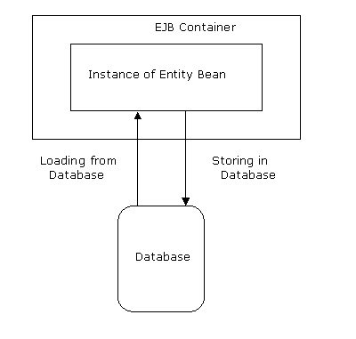
Overview of Entity Beans (Contd.)
  Use of Entity beans
    EJB container creates instances of an entity bean and is responsible for loading data in an instance and storing the information back into the database.
    Loading and Storing of Data:

Slide 132
Overview of Entity Beans (Contd.)
    An instance of an entity bean is a recyclable object. This means that EJB container places instances in an instance pool from where they can be reused as and when necessary to service multiple clients.
    The entity bean instances are assigned to clients randomly. An instance, when assigned to a client, is allocated certain resources.
    EJB container releases the resources allocated to an instance when it is no longer assigned to a client.

Slide 133
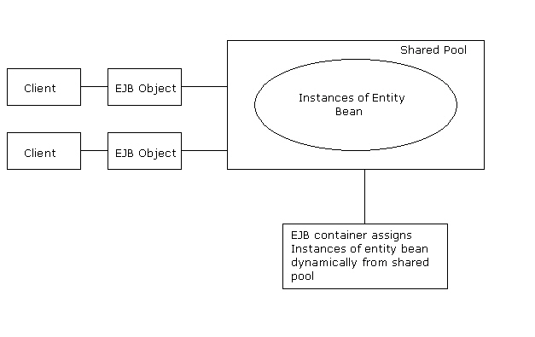
Overview of Entity Beans (Contd.)
    Pooling of Instances of an Entity Bean:

Slide 134
Overview of Entity Beans (Contd.)
  Characteristics of Entity Beans:
    Persistence: An entity bean is persistent in that its state exists even after a client stops accessing an application.
    Shared Access: Multiple clients can share one entity bean by using separate instances of the entity bean.
    Primary Key: Each entity bean has a unique identifier associated with it, known as primary key. A client uses the entity bean’s unique identifier in order to access a specific entity bean for performing operations.

Slide 135
Overview of Entity Beans (Contd.)
  Types of Entity Beans
    Bean-managed persistent (BMP) entity bean: Contains the code to perform operations on the data stored in a database. You can change the code to reflect changes in the database or user requirements.
    Container-managed persistent (CMP) entity bean: Uses EJB container to perform persistence operations. A CMP entity bean is independent of the database.

Slide 136
Bean-Managed Persistence (BMP) Entity Beans
  A BMP entity bean contains the code required for managing persistence of the entity bean.
  Persistence operations include storing, loading, and searching data in a database
  The code for managing the relationships needs to be written at the time of bean development.
  Database access API, such as JDBC and SQL/J can be used for writing the code to manage the persistence.

Slide 137
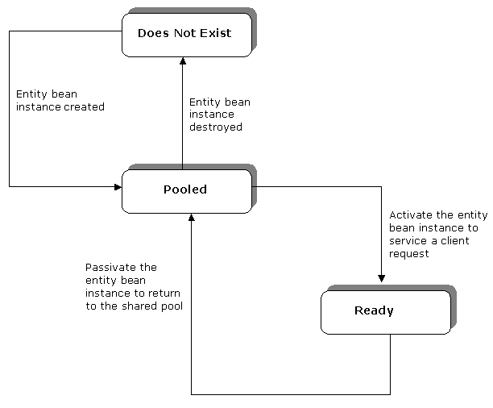
Bean-Managed Persistence (BMP) Entity Beans (Contd.)
  Life cycle of BMP Entity Beans:
    The three stages in the life cycle of a BMP entity bean are:
      Pooled
      Ready
      Does Not Exist

Slide 138
Bean-Managed Persistence (BMP) Entity Beans (Contd.)
    The Pooled Stage
      At the beginning of the life cycle, an entity bean is in the Pooled stage.
      EJB container creates instances of an entity bean by invoking the newInstance() method. This method instantiates an entity bean by calling its default constructor.
      EJB container invokes the setEntityContext() method, after instantiating the entity bean to associate the bean with context information.
      The setEntityContext() method can also be used to allocate the resources that will be used by the instance of the entity bean until it moves to the Does Not Exist stage.

Slide 139
Bean-Managed Persistence (BMP) Entity Beans (Contd.)
    The entity bean, in the pooled stage can use the following methods:
      ejbCreate(): Validates the arguments supplied by the client in order to initialize an entity bean.
      ejbPostCreate(): Passes the reference of an EJB object to other entity beans.
      ejbFind<..>(): Enables you to locate entity bean instances based on its primary key or fields.
      ejbHome<..>() method: Performs operations that are not linked to a specific data instance.
      unsetEntityContext() method: Allows you to unset the entity context.

Slide 140
Bean-Managed Persistence (BMP) Entity Beans (Contd.)
    The Ready Stage
      An entity bean moves to the Ready stage to service the requests generated by a client.
      EJB container calls the ejbCreate() and ejbPostCreate() methods to move the entity bean from the Pooled stage to the Ready stage.
      The methods used in the Ready stage are:
        ejbLoad(): Enables an entity bean instance to read data from a database.
        ejbStore(): Transfers the modified information from the entity bean instance to a database.

Slide 141
Bean-Managed Persistence (BMP) Entity Beans (Contd.)
      A client moves an entity bean from the Ready stage to the Pooled stage by calling the remove() method.
      EJB container then calls the ejbRemove() method that removes the information associated with the entity bean.
      An entity bean can also move from the Ready stage to the Pooled stage when EJB container calls the ejbPassivate() method.

Slide 142
Bean-Managed Persistence (BMP) Entity Beans (Contd.)
    The Does Not Exist stage
      At the end of its life cycle, an entity bean is in the Does Not Exist stage.
      In this stage, an entity bean is removed from the pool.
      The unsetEntityContext() method can be implemented to destroy all resources acquired by an instance before removing it from the pool.

Slide 143
Bean-Managed Persistence (BMP) Entity Beans (Contd.)
  EJB Entity Context
    An enterprise bean has a context object that contains the information about its environment, such as security and transaction information.
    In an entity bean, the javax.ejb.EntityContext interface contains the information about the environment of the entity bean.
    Methods specified in the javax.ejb.EntityContext interface are:
      getEJBObject(): Returns the REMOTE [component] interface of an entity bean.
      getEJBLocalObject(): Returns the LOCAL [component] interface of an entity bean.
      getPrimaryKey(): Returns the primary key that is associated with an entity bean.

Slide 144
Bean-Managed Persistence (BMP) Entity Beans (Contd.)
    The EntityContext extends the javax.ejb.EJBContext interface. The EJBContext object is used in an entity bean to find the status of a transaction.
    The methods in the javax.ejb.EJBContext interface are:
      getEJBHome(): Returns the remote home interface of an entity bean.
      getEJBLocalHome(): Returns the local home interface of an entity bean.
      getCallerPrincipal(): Returns the java.security.Principal interface, which is used to find information about the caller of the instance of the entity bean.
      isCallerInRole(): Checks if the caller of the instance of the entity bean instance is associated with a particular role.

Slide 145
Bean-Managed Persistence (BMP) Entity Beans (Contd.)
        setRollbackOnly(): Enables an instance to mark a transaction for rollback.
        getRollbackOnly(): Enables an instance to check if a transaction is marked for rollback.
        getUserTransaction(): Returns the javax.transaction.UserTransaction interface. This method is used only in those session and message-driven beans, which implement bean-managed transactions.

Slide 146
Creating BMP Entity Beans
  The process of creating a BMP entity bean consists of:
    Configuring the database
    Creating a set of enterprise bean class files
  A BMP entity bean consists of the following files:
    BMP entity bean remote or local interface
    BMP entity bean remote home or local home interface
    BMP entity bean class

Slide 147
Creating BMP Entity Beans(Contd.)
  Configuring a Data Source
    The process of configuring the data source consists of creating tables in a database for storing the state of the BMP entity bean.
    After creating the required tables in the database, the database needs to be configured with the J2EE 1.4 Application Server.
    The J2EE Admin Console utility is used to configure a database with the J2EE 1.4 Application Server.

Slide 148
Creating BMP Entity Beans (Contd.)
  Creating a BMP Entity Bean Remote Interface
    An entity bean remote interface declares the business methods used by a client.
    The remote interface consists of a set of methods corresponding to the methods that are present in the entity bean class.
    The signatures of the methods in the remote interface should be the same as the corresponding methods in the entity bean class.
    The remote interface extends the javax.ejb.EJBObject interface and consists of the declaration of the business methods.
    The throw clause of the methods that are declared in the remote interface should include the exception, java.rmi.RemoteException.

Slide 149
Creating BMP Entity Beans (Contd.)
  Creating a BMP Entity Bean Local Interface
    A local client uses the local interface to call the entity bean.
    The local interface of an entity bean extends the javax.ejb.EJBLocalObject interface.
    The methods that are declared in the local interface need to have the corresponding methods with the same signature in the entity bean class.

Slide 150
Creating BMP Entity Beans (Contd.)
  Creating a BMP Entity Bean Remote Home Interface
    The remote home interface of an entity bean includes the methods that enable a client to create, locate, or destroy the entity bean.
    The methods in the remote home interface should have a corresponding set of methods in the entity bean class.
    The signatures of the methods in the remote home interface should be the same as the corresponding methods in the entity bean class.
    The remote home interface of a BMP entity extends the javax.ejb.EJBHome interface and includes the findByPrimaryKey() method.
    The methods in the remote home interface should throw the exception, java.rmi.RemoteException.

Slide 151
Creating BMP Entity Beans (Contd.)
  Creating a BMP Entity Bean Local Home Interface
    The local home interface of an entity bean includes the methods to create, locate, and destroy an entity bean.
    The methods in the local home interface need to have the corresponding methods in the entity bean class with the same signature.
    The local home interface of an entity bean extends the javax.ejb.EJBHome interface.

Slide 152
Creating BMP Entity Beans (Contd.)
  Creating a BMP Entity Bean Class
    The entity bean class:
      Implements the life cycle methods used by EJB container to control the life cycle of an entity bean.
      Implements the business methods declared in the entity bean remote interface.
      Can only be defined as public and implements the business methods defined in the component interfaces of an entity bean.
      Implements the javax.ejb.EntityBean interface.
      Includes a default constructor that does not have any arguments.
      Should implement the ejbCreate(), ejbPostCreate(), ejbFind(), and ejbHome() methods.

Slide 153
Creating BMP Entity Beans (Contd.)
  Deployment Descriptor of a BMP Entity Bean:
    Uses the following deployment descriptor tags to specify a BMP entity bean's characteristics and requirements.
    Has the following tags:
      <ejb-name> : Specifies a name for the entity bean.
      <home> : Specifies the home interface name of the entity bean.
      <remote> : Specifies the remote interface name of the entity bean.
      <ejb-class> : Specifies the class name of the entity bean.
      <transaction-type>: Specifies that EJB container should handle the transactions of the entity bean.
      <persistence-type>: Specifies whether the entity bean has container-managed persistence or bean-managed persistence.
      <prim-key-class>: Specifies the primary key class of the bean.

Slide 154
Creating BMP Entity Beans (Contd.)
      <reentrant>:Specifies if a bean can invoke itself by using another bean.
      <resource-ref>: Enables setting up the JDBC driver and ensures its availability at a proper JNDI location.
      <assembly-descriptor>: Specifies whether a transaction is associated with the bean or not.

Slide 155
Creating BMP Entity Beans (Contd.)
  Compiling and Deploying BMP Entity Bean
    The compiled Java class files of a BMP entity bean are deployed in the J2EE 1.4 Application Server using the deploytool utility.
    The New Enterprise Bean Wizard of the deploytool utility is used to deploy a BMP entity bean.
    The deploytool utility packages the compiled Java class files in a JAR file.
    While packaging, a BMP entity bean is linked with a database using the JDBC Resource reference specified while configuring the database.
    The packaged JAR file is then deployed in the J2EE 1.4 Application Server as a J2EE application EAR file.
    The deploytool utility automatically generates the deployment descriptor of a BMP entity bean.

Slide 156
Creating BMP Entity Beans (Contd.)
  Accessing BMP Entity Bean
    A client accesses a BMP entity bean’s business methods using the references of entity bean’s home and remote interfaces.
    Both, Web clients and Application clients can access a BMP entity bean.
    The steps to access a BMP entity bean are:
      Locates a BMP entity bean in the J2EE 1.4 Application Server.
      Retrieves references of the BMP entity bean home and remote interfaces.

Slide 157
Creating BMP Entity Beans (Contd.)
    Locating a BMP entity Bean
      To locate a BMP entity bean, the client performs the following steps:
        Uses the InitialContext interface of JNDI to create an initial naming context.
        Uses the lookup() method to locates the home object of the deployed BMP entity bean.

Slide 158
Creating BMP Entity Beans (Contd.)
    Retrieving References of BMP Entity Bean Interfaces
      After locating the BMP entity bean, a client retrieves references of the BMP entity bean home and remote interfaces to invoke an entity bean’s business methods.
      The narrow() method of the PortableRemoteObject interface is used to retrieve the reference of a BMP entity bean remote home interface.
      Local clients need to use lookup() method of the InitialContext interface to retrieve a reference of a BMP entity bean local home interface.
      A client invokes the create() method in the BMP entity bean home interface for retrieving a reference to BMP entity bean remote interface.
      A local client invokes the create() method to retrieve a reference to a BMP entity bean local interface.

Slide 159
Creating BMP Entity Beans (Contd.)
  Handling Exceptions in EJB
    Two types of exceptions thrown by a BMP entity bean are:
      System: Is thrown when an error occurs in the services that an application uses. Two types of system exceptions are:
        NoSuchEntityException: Is thrown if a BMP entity bean method is not able to find the database row that has to be updated or loaded.
        EJBException: Is thrown if a system related error occurs that does not allow a BMP entity bean method to execute successfully

Slide 160
Creating BMP Entity Beans (Contd.)
    Application: Is defined in the throw clause of a method.
    Two types of application-level exceptions are:
      Predefined exceptions: Include the exceptions that are already defined in a built-in package, such as javax.ejb.
      Customized exceptions: Include the exceptions for which you provide the definition.
      The predefined application-level exceptions defined in the javax.ejb package are:
        CreateException
        DuplicateKeyException
        RemoveException
        FinderException
        ObjectNotFoundException

Slide 161
Creating BMP Entity Beans (Contd.)
    Client View Of Exceptions
      There can be any number of application exceptions in the throw clause of the BMP entity bean methods.
      The throw clause, present in all methods in the remote home and remote interfaces, includes the java.rmi.RemoteException exception.
      An application exception does not alter the state of the BMP entity bean. EJB container allows a client to continue invoking the BMP entity bean if an application exception is thrown.
      The javax.ejb.EJBException exception is thrown when a local client is not able to call a BMP entity bean successfully.

Slide 162
Demonstration - Implementing BMP Entity Beans
  Problem Statement
    Chris is developing an online banking application to facilitate users to perform online banking transactions. A user needs to first register by creating an online account. Details of the new user are stored in a database. Chris decides to store the user information in the database using the BMP entity beans. As the clients of the application are remote clients, Chris needs to implement remote interfaces of the bean.

Slide 163
Demonstration - Implementing BMP Entity Beans (Contd.)
  Solution
    To solve the above problem, perform the following tasks:
    1. Configure a data source with the J2EE Application Server.
    2. Create the BMP entity bean home interface.
    3. Create the BMP entity bean remote interface.
    4. Create the BMP entity bean class.
    5. Create the Web Client.
    6. Package the BMP entity bean.
    7. Package the Web Client.
    8. Deploy the application.
    9. Test the application.

Slide 164
Summary
In this lesson, you learned:
  An entity bean is used to store and access data from a database. An entity bean represents a persistent object stored in a database.
  The characteristics of an entity bean are persistence, shared access, and primary key.
  The two types of entity bean, depending on the persistence mechanisms, are BMP entity bean and CMP entity bean.
  A BMP entity bean life cycle consists of three stages, Pooled, Ready, and Does Not Exist.
  EJB container passivates and activates entity bean instances to reduce the overhead of maintaining large number of bean instances in the pool.
  The javax.ejb.EntityContext interface contains the information regarding the environment of the entity bean.

Slide 165
Summary (Contd.)
  To create a BMP entity bean, you need to perform the following tasks:
    Create the BMP entity bean home interface
    Create the BMP entity bean remote interface
    Create the BMP entity bean class
  The bean provider provides the bean class, the remote interface, and the home interface for a BMP entity bean.
  EJB container manages the bean instances and provides the deployment tool required for deploying the bean.
  The two types of exceptions thrown by an entity bean are system exceptions and application exceptions.
  The two system exceptions thrown by a BMP entity bean are NoSuchEntityException and EJBException.

Slide 166
Container Managed Persistence

Slide 167
Objectives
  In this lesson, you will learn to:
    Identify need for Container-Managed Persistence (CMP) Entity Beans
    Describe characteristics of CMP Entity Beans
    Explain the life cycle of CMP Entity Beans
    Create and deploy CMP Entity Beans
    Develop an application using CMP Entity Bean

Slide 168
Pre-assessment Questions
  Identify the characteristic of a BMP entity bean that defines that the state of a BMP entity bean exists even after a client stops accessing an application.
    Persistence
    Shared Access
    Primary Key
    Consistent
  The EJB Container calls the ejbCreate() and ___________ methods to move the entity bean from the Pooled stage to the Ready stage.
    ejbActivate()
    create()
    ejbLoad()
    ejbPostCreate()

Slide 169
Pre-assessment Questions (Contd.)
  Which method in the javax.ejb.EntityContext interface enables an instance to check if a transaction is marked for rollback?
    isCallerInRole()
    getUserTransaction()
    getRollbackOnly()
    setRollbackOnly()
  The EJBException is an example of _________________ and CreateException is an example of ____________ exception.
    System Exception, Customized exception
    Customized exception, System Exception
    Predefined exception, System exception
    System exception, Predefined exception

Slide 170
Pre-assessment Questions (Contd.)
  Local clients retrieve BMP entity bean local home interface reference using the lookup() method of the ______________ interface.
    PortableRemoteObject
    InitialContext
    EntityBean
    EJBHome

Slide 171
Solutions to Pre-assessment Questions
  a. Persistence
  d. ejbPostCreate()
  c. getRollbackOnly()
  d. System exception, Predefined exception
  b. InitialContext

Slide 172
Overview of CMP Entity Beans
    In CMP entity bean, EJB container manages the persistence logic.
    The bean provider needs to specify the necessary mapping between the bean attributes and the persistent storage to enable EJB container to implement persistence logic.

Slide 173
Overview of CMP Entity Beans
  Characteristics of CMP Entity Beans
    The instances and fields of a CMP entity bean are mapped with a specific database such that a change in one is automatically reflected in the corresponding database object as well.
    The bean deployer determines how to perform the synchronization. EJB container automatically implements the mapping specified by the bean deployer.
    The bean developer does not need to write code for making database calls. The bean deployer uses the EJB tools provided by the vendor to map the persistent fields in the bean to the database at the time of deploying the CMP entity bean.

Slide 174
Overview of CMP Entity Beans
(Contd.)
    The CMP entity beans enable you to:
      Declare the CMP entity bean class as abstract. EJB container provides the actual implementation of the CMP entity bean.
      Declare two abstract methods corresponding to a CMP field. EJB container performs the actual implementation of these methods. These abstract methods are:
        set type: Sets the values of a CMP field.
        get type: Retrieves the values of a CMP field.
      Use EJB Query Language (EJB QL) statements in your CMP entity bean to query databases. EJB QL is a set of statements introduced in the EJB 2.0 specification. The syntax and structure of the EJB QL statements is similar to the structure of Structured Query Language (SQL) statements.

Slide 175
Overview of CMP Entity Beans
(Contd.)
    Implement Data Definition Language (DDL) statements in CMP entity beans using EJB QL statements.
    Change the persistence representation from object database to relational database without changing a data logic method. In CMP entity beans, data logic methods and persistence representation are defined separately.
    Change the database platform used as a back end in a CMP application. The code to implement a CMP entity bean is not specific to any database platform and does not involve hard coding the SQL statements.
    Use the file server instead of an RDBMS as the back end of a CMP application. The records are stored in the files and these files are stored in the file server.

Slide 176
Overview of CMP Entity Beans
(Contd.)
    While developing CMP entity bean applications, you can implement relationships between entity beans.
    Relationships refer to the association of one bean with another.
    In CMP entity bean, EJB container handles the relationships between entity beans. This is known as Container-Managed Relationship (CMR).

Slide 177
Overview of CMP Entity Beans
(Contd.)
  Difference between BMP and CMP Entity Beans
    The following table describes the differences between BMP and CMP entity beans:
Feature
CMP Entity Bean
BMP Entity Bean
Implementation
EJB container provides the persistence logic automatically.
You need to write the persistence logic for the BMP entity bean.

Slide 178
Overview of CMP Entity Beans
(Contd.)
    Difference between BMP and CMP Entity Beans: (Contd.)
Feature
CMP Entity Bean
BMP Entity Bean
Maintenance
You only need to maintain the business logic code. The deployment tool generates complex data access and management code automatically.
You need to maintain both data access and business logic code of your application.
Portability
You can make minor modifications and reuse a CMP entity bean with other database technologies.
You need to hard code the logic to query and define a database and handle persistence

Slide 179
Overview of CMP Entity Beans
(Contd.)
    Difference between BMP and CMP Entity Beans: (Contd.)
Feature
CMP Entity Bean
BMP Entity Bean
Flexibility
You apply the abstract persistent schema to declare the CMP and CMR fields and then write the query using the EJB QL in the deployment descriptor. The deployment tool generates the SQL query for a relational database or the Object Query Language (OQL) query for an object database.
You need to write SQL statements if you are using a relational database or OQL statements for an object database. As a result, third-party EJB software needs to provide two separate sets of code and data access objects for object database and relational database.

Slide 180
Overview of CMP Entity Beans
(Contd.)
    Difference between BMP and CMP Entity Beans: (Contd.)
Feature
CMP Entity Bean
BMP Entity Bean
Referential Integrity
EJB container provides referential integrity.
You need to provide the logic to implement referential integrity.

Slide 181
Overview of CMP Entity Beans
(Contd.)
  Life Cycle of a CMP Entity Bean
    The stages in the life cycle of a CMP bean are:
      Does Not Exist
      Pooled
      Ready

Slide 182
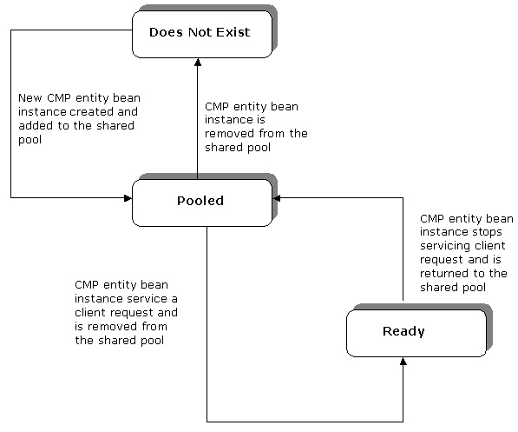
Overview of CMP Entity Beans
(Contd.)
    Life cycle of a CMP entity bean

Slide 183
Overview of CMP Entity Beans
(Contd.)
    The Does Not Exist Stage
      The Does Not Exist stage indicates that the CMP entity bean is yet to be instantiated or has been removed by EJB container.
      EJB container executes the newInstance() and the setEntityContext() methods while creating a new bean instance.
      The newInstance() method is used to create a new instance of a CMP entity bean.
      The setEntityContext() method passes an entity context object to the entity bean as a variable and associates a CMP entity bean with an entity context object.

Slide 184
Overview of CMP Entity Beans (Contd.)
    The Pooled Stage
      The Pooled stage indicates that the bean has been instantiated and is not associated with any client. In this stage, a set of bean instances exists in a pool.
      When a client releases the bean instance, it is returned to the pool.
      In this stage, EJB container dynamically updates the entity context. As a result, data in the entity context is updated every time a client invokes an entity bean.

Slide 185
Overview of CMP Entity Beans (Contd.)
    EJB container calls the ejbHome() method to perform generic tasks that are common across all data instances.
    A client calls the create() method, declared in the home interface, when it needs to acquire an instance of a bean. EJB container, in turn, calls the ejbCreate() method, declared in the bean class. This results in associating a bean instance with a client.
    After executing the ejbCreate() method, EJB container invokes the ejbPostCreate() method. Each ejbCreate() method has a corresponding ejbPostCreate() method defined in the bean.
    The parameters of the ejbPostCreate() method are the same as that of the create() method in the home interface.

Slide 186
Overview of CMP Entity Beans (Contd.)
    EJB container calls the ejbActivate() method to restore the resources, which were initially deactivated using the ejbPassivate() method. The stage of the bean is changed from Pooled to Ready, while executing the ejbActivate() method.
    An invocation of the ejbActivate() method is succeeded by an invocation of the ejbLoad() method.
    EJB container invokes the ejbLoad() method to retrieve data from the database and initialize a bean instance with the retrieved data.
    The finder methods, such as ejbFind() and ejbFindByPrimaryKey() are used to locate and retrieve entity bean data. EJB container automatically generates the logic to be implemented for finder methods.
    The finder methods can return a single instance of an EJB object or a set of EJB objects.

Slide 187
Overview of CMP Entity Beans (Contd.)
    The Ready Stage
      The Ready stage involves acquiring necessary resources, performing database operations, applying the relevant business logic, and storing the modified data back to the database.
      The ejbSelect () method is used for handling databases.
      The difference between a finder method and the ejbSelect() method is that the ejbSelect() method is not exposed to a client.
      Clients can only access the ejbSelect() method through EJB container.

Slide 188
Overview of CMP Entity Beans (Contd.)
      The ejbStore() method writes the data stored in the memory to the database. This method updates a database with the in-memory values of the fields of a database object, such as table.
      The deactivation of a bean takes place either when a client wants to deactivate it or when EJB container detects that a client has timed out. Deactivation of a bean is also called passivation.
      The ejbPassivate() method deactivates a bean and releases its resources. When the bean instance is deactivated, it is detached from the client and returned to the pool of free bean instances.
      While executing the ejbPassivate() method, the bean instance is transferred from the Ready stage to the Pooled stage.

Slide 189
Overview of CMP Entity Beans (Contd.)
    Client can also disassociate an instance of a bean by invoking the remove() method of the home interface.
    The remove() method invokes its corresponding ejbRemove() method, declared in the bean class, to remove the specified bean instance.
    EJB container:
      Reduces the size of the pool by removing bean instances. It uses the unsetEntityContext() method to disassociate the resources allocated to a bean instance while executing the setEntityContext() method.
      Invokes the finalize() method to make the bean instance eligible for garbage collection by the JVM garbage collection unit, also known as the Java garbage collector.
    The bean instance moves to the Does Not Exist stage after the garbage collection process.

Slide 190
Creating a CMP Entity Bean
  The process of developing a CMP bean consists of the following tasks:
    Writing the Java files for implementing the classes and interfaces.
    Compiling the Java files to create class files.
    Creating a client program.
    Packaging and deploying the application.

Slide 191
Creating a CMP Entity Bean
  Creating Java Files for a CMP Entity Bean
    A CMP entity bean having remote clients consists of following Java files:
      Home interface
      Remote interface
      Bean class
    Information about CMP fields is specified in the deployment descriptor.
    You also need to create the primary key class to state the primary key of the database table used in the CMP entity bean.

Slide 192
Creating a CMP Entity Bean (Contd.)
  Creating a CMP Entity Bean Home Interface
    The home interface is used to create a bean instance, find an existing bean instance, and remove a bean instance.
    While using the remote interface, the home interface extends the javax.ejb.EJBHome interface.
    While using the local interface, the home interface extends the javax.ejb.EJBLocalHome interface.

Slide 193
Creating a CMP Entity Bean (Contd.)
    Creating a CMP Entity Bean Local and Remote Interfaces
      A remote client uses the remote and the remote home interfaces to access a CMP entity bean.
      A local client uses the local and the local home interface to access a CMP entity bean.
      The remote and remote home interfaces are together called remote client view. The remote client view can be mapped to both, Java and non-Java client environments.
      The remote client view of an entity bean is location-independent. This means that a client running in the same JVM as an entity bean instance uses the same API to access the entity bean as a client running in a different JVM.
      The pass by value method is used to pass the arguments to methods declared in the remote and the remote home interfaces.

Slide 194
Creating a CMP Entity Bean (Contd.)
    The remote home interface of a CMP entity bean enables a client to perform the following tasks:
      Create a new entity object
      Find an existing entity object
      Remove an entity object
    The remote client view becomes an overhead if both, the client and the CMP entity bean are hosted in the same JVM. In such a situation, you can replace a remote client view with a local client view.

Slide 195
Creating a CMP Entity Bean (Contd.)
    A local client accesses a CMP entity bean using the local and the local home interfaces of the CMP entity bean.
    The local interface and local home interface are together called the local client view, which is location-dependent. This means that the client and the CMP entity bean should operate within the same JVM. As a result, the local client view does not provide location transparency.
    The EJB container enables the local clients to access the local home interface using JNDI.
    The local home interface of a CMP entity bean enables a local client to perform the same functions as remote home interface does for remote clients.

Slide 196
Creating a CMP Entity Bean (Contd.)
    Creating a Bean Class for CMP Entity Bean
      The bean class is created by implementing the EntityBean interface. The bean class consists of set and get methods for CMP fields and functions for bean life cycle and EJB context.
      The bean class is declared as abstract and EJB container generates the code for the actual implementation of the bean.

Slide 197
Creating a CMP Entity Bean (Contd.)
    Creating the Primary Key Class
      You need to create a primary key class to specify the primary key for the table that you are using in the bean.
      EJB container, while handling database calls, uses this primary key class to uniquely identify a record in a table.
      In CMP, a primary key class should be made serializable by implementing the java.io.Serializable interface. This allows the client and server to exchange keys.

Slide 198
Creating a CMP Entity Bean (Contd.)
    The Deployment Descriptor
      In a CMP entity bean, information about persistence is specified in the deployment descriptor. This information is known as abstract persistence schema.
      The tags used in the deployment descriptor of a CMP entity bean are:
        <persistence-type>…</persistence-type>: Specifies the type of bean persistence strategy. You specify the value, Container, for indicating container-managed persistence.
        <cmp-version>…</cmp-version>: Specifies the version of the EJB specification.
        <abstract-schema-name>…</abstract-schema-name>: Specifies the alias of the abstract persistence schema.
        <cmp-field>…</cmp-field>: Contains information about a CMP field.

Slide 199
Creating a CMP Entity Bean (Contd.)
      <fieldname>…</fieldname>: Specifies the name of a bean attribute or the name of a CMP field. This tag is written within a pair of <cmp-field> and </cmp-field> tags.
      <primkey-field>…<primkey-field>: Specifies the name of the primary key field. You should declare this field as public in the bean class using the same name as indicated in this tag.
      <primkey-class>…</primkey-class>: Specifies the type of the primary key field. It can be a data type, such as integer or character, a serializable class, or an auto-generated primary key.

Slide 200
Creating a CMP Entity Bean (Contd.)
  Responsibilities of Bean Provider, Application Assembler, and Container Provider
    The bean provider is responsible for developing enterprise bean and the ejb-jar files for storing these beans.
    The application assembler groups enterprise beans into a single deployment module or unit.
    The application assembler receives one or more ejb-jar files as input and combines them into a single ejb-jar file as output.
    Depending upon the structure of the application, application assembler may need to split a large ejb-jar file into multiple ejb-jar files, where each generated ejb-jar file is a single deployment module.
    The container provider supplies the tools required for reading and importing deployment descriptor information and implementing the tasks of a container.
    The container provider also supplies the tools to implement the get and set methods by generating the code for them.

Slide 201
Creating a CMP Entity Bean (Contd.)
    While implementing a bean, bean provider, application assembler, and container provider should maintain a programming contract.
    Programming contract refers to a set of rules regarding the correct usage of software modules. The software modules at the server and the client end have to adhere to this programming contract.
    Any violation of the programming contract leads to software failure.
    Programming contract consists of the following rules:
      The bean provider should define the CMP entity bean class as abstract.
      The CMP bean provider should not declare the CMP and CMR fields in the CMP bean class because the container generates the code to implement these fields.
      The bean deployer should specify the CMP and CMR fields in the deployment descriptor. The names of these fields should be valid Java identifiers. This means that these names should begin with a lowercase letter and should not be Java keywords.

Slide 202
Creating a CMP Entity Bean (Contd.)
      The bean provider should define the get and set type methods for the CMP and CMR fields using the JavaBeans conventions. EJB container implements these methods while deploying the application.
      The bean provider should declare the get and set methods as abstract and public. In the names of these methods, the first letter of the name of the CMP or CMR field is changed to uppercase and prefixed by the strings, get or set.
      The get and set type methods for CMR fields that are used to implement one-to-many or many-to-many relationships should utilize either the java.util.Collection or the java.util.Set collection interface.

Slide 203
Creating a CMP Entity Bean (Contd.)
      An entity bean local interface type data or its collection can be the type of a CMR field. However, it cannot be the type of a CMP field.
      Te bean provider should not change the primary key of an entity bean, once it has been set.
      The bean provider should ensure that the types assigned to the CMP fields are compatible with the Java primitive types and the Java serializable types.

Slide 204
Demonstration - Implementing CMP Entity Beans
  Problem Statement
    Chris is developing an online banking application. Registered users perform online transactions using this application. Details of the transactions performed are stored in a database. Chris needs to store banking transaction details using CMP entity beans.

Slide 205
Demonstration - Implementing CMP Entity Beans (Contd.)
  Solution
    To solve the above problem, perform the following tasks:
      Create the CMP entity bean home interface.
      Create the CMP entity bean remote interface.
      Create the CMP entity bean class.
      Create the Web Client.
      Package the CMP entity bean.
      Package the Web Client.
      Deploy the application.
      Test the application

Slide 206
Summary
In this lesson, you learned:
  In a CMP entity bean, you need not write JDBC code. EJB container handles the connectivity between the application and the database and enables you to create platform-independent code.
  In a CMP entity bean, EJB container manages the persistence logic. The bean provider only needs to specify the necessary mapping between the bean attributes and the persistent storage.
  The CMP entity bean class is declared as abstract and EJB container provides the actual implementation of the bean.
  To specify a CMP field, you should declare two abstract methods and the actual implementation of the methods is provided by EJB container.
  EJB QL statements are used in the CMP entity bean to query databases.
  The code to implement a CMP entity bean is not specific to any database platform and does not involve hard coding the SQL statements.

Slide 207
Summary (Contd.)
  The stages in the life cycle of a CMP bean are: Does Not Exist, Pooled, and Ready.
  To create a CMP entity bean, you need to perform the following tasks:
    Create CMP entity bean remote home or local home interface
    Create CMP entity bean remote of local interface
    Create a bean class
    Create a client program
  The home interface of a CMP entity bean is used to create a new instance, find an existing instance, and remove an instance of a bean.
  The client of a CMP entity bean is either remote or local. A remote client uses the remote and the remote home interfaces to access a CMP entity bean. A local client uses the local and the local home interface to access a CMP entity bean.

Slide 208
Summary (Contd.)
  A primary key class specifies the primary key for the table that is used in the bean. EJB container uses this primary key class to uniquely identify the records in a table.
  In a CMP entity bean, information about persistence is specified in the deployment descriptor.

Slide 209
EJB 3.0

Slide 210
Ease of Development Goal
Simplify EJB — make it easier to use
  Simplified set of APIs
  Eliminate deployment descriptor
  from developer's view
  Facilitate test-driven development
  Improve developer productivity
Capture broader range of developers
  Make it simpler for average developer
  Increase developer base,
  target more corporate developers

Slide 211
EJB 2.1 Session Bean
  import javax.ejb.EJBObject;
  import java.rmi.RemoteException;
  public interface Cart extends EJBObject
  {
  public void add(String item) throws RemoteException;
  public Collection getItems() throws RemoteException;
  public void completeOrder() throws RemoteException;
  }
  import javax.ejb.*;
  import java.rmi.RemoteException;
  public interface CartHome extends EJBHome
  {
  public Cart create() throws CreateException,
  RemoteException;
  }
Notes:
Business interface has business methods, needs to extend EJBObject, needs to throw RemoteException. RMI is physically exposed in business model.
Home just needs a create method for session beans.

Slide 212
EJB 2.1 Session Bean Class
  import javax.ejb.*;
  public class CartEJB implements SessionBean {
  protected Collection items = new ArrayList();
  public void add(String item) {
  items.add(item);
  }
  public Collection getItems() {
  return items;
  }
  public void completeOrder(){ .. }
  public void ejbCreate(){}
  public void ejbRemove(){}
  public void ejbActivate(){}
  public void ejbPassivate(){}
  public void setSessionContext(SessionContext context){}
  }

Slide 213
EJB 2.1 Deployment Descriptor
  <session>
  <display-name>Shopping Cart</display-name>
  <ejb-name>MyCart</ejb-name>
  <home>CartHome</home>
  <remote>Cart</remote>
  <ejb-class>CartEJB</ejb-class>
  <session-type>Stateful</session-type>
  <transaction-type>Container</transaction-type>
  </session>
  …
  <assembly-descriptor>
  <container-transaction>
  <method> …
  </method>
  <trans-attribute>Required</trans-attribute>
  </container-transaction>
  </assembly-descriptor>

Slide 214
EJB 3.0 Session Bean
  public interface Cart {
  public void add(String item);
  public Collection getItems();
  public void completeOrder();
  }

Slide 215
EJB 3.0 Session Bean
  @Remote
  public interface Cart {
  public void add(String item);
  public Collection getItems();
  public void completeOrder();
  }

Slide 216
EJB 3.0 Session Bean class
  import javax.ejb.*;
  public class CartBean implements Cart {
  private ArrayList items;
  public void add(String item) {
  items.add(item);
  }
  public Collection getItems() {
  return items;
  }
  public void completeOrder() {...}
  }

Slide 217
EJB 3.0 Session Bean class
  import javax.ejb.*;
  @Stateful
  public class CartBean implements Cart {
  private ArrayList items;
  public void add(String item) {
  items.add(item);
  }
  public Collection getItems() {
  return items;
  }
  @Remove
  public void completeOrder() {...}
  }

Slide 218
Deployment Descriptor
Notes:
May do security configuration in deployment descriptor instead of code. However, don’t need to repeat information in annotations, just what you want to override or add.

Slide 219
Significant Simplifications
Eliminated requirement for Home Interface
  Not needed for session beans
Business interface is a POJI
  Don’t need to extend specific interface
  Bean implements business interface
  Bean can have more than one business interface
  RemoteExceptions are removed from programmer and client view
Eliminated requirement for unnecessary callback methods
  Removed requirement to implement javax.ejb.SessionBean
Notes:
In EJB 2.1 you could not implement the business interface as then it would require all the methods defined by EJBObject.
Don’t need to explicitly write to RMI interface, don’t need to deal with remote exceptions.

Slide 220
Simplified Access to
Bean's Environment
Get JNDI APIs out of developer's view
  Not at all a good “hello world” experience
Declarative expression of dependencies in metadata
Techniques/Mechanism
  Container injection of resource entries, etc.
  Simple programmatic lookup mechanisms
Different usages, both have their place
  Very simple; facilitates testability
  (especially setter injection techniques)
  More flexible; dynamic
Notes:
Injection happens when the bean is constructed, whereas programmatically it happens when the code is actually executed.

Slide 221
Example
@Stateless public class MySessionBean {
  @Resource public DataSource customerDB;
  public void myMethod (String myString){
  try {
  Connection conn =
  customerDB.getConnection();
  ...
  } catch (Exception ex) {...}
  }
}
Notes:
CustomerDB will be set up for me already

Slide 222
With Setter Injection
@Stateless public class MySessionBean {
  private DataSource customerDB;
  @Resource
  public void setDataSource(DataSource myDB) {
  customerDB = myDB;
  }
  public void myMethod (String myString){
  ...
  Connection conn = customerDB.getConnection();
  ...
  }
}
Notes:
Another style choice if you want to make a datasource private
Advantage for using Junit testing as it simulates setting of the variable by the container (which doesn’t exist in a testing environment)

Slide 223
EJB 3.0 Entity Bean
public class Customer {
  private String name;
  private Account account;
  public String getName() { return name; }
  public void setName(String name) {
  this.name = name;
  }
  public Account getAccount() { return account; }
  public void setAccount(Account account) {
  this.account = account;
  }
}

Slide 224
EJB 3.0 Entity Bean
@Entity public class Customer {
  private String name;
  private Account account;
  @Id public String getName() { return name; }
  public void setName(String name) {
  this.name = name;
  }
  @OneToOne
  public Account getAccount() { return account; }
  public void setAccount(Account account) {
  this.account = account;
  }
}

Slide 225
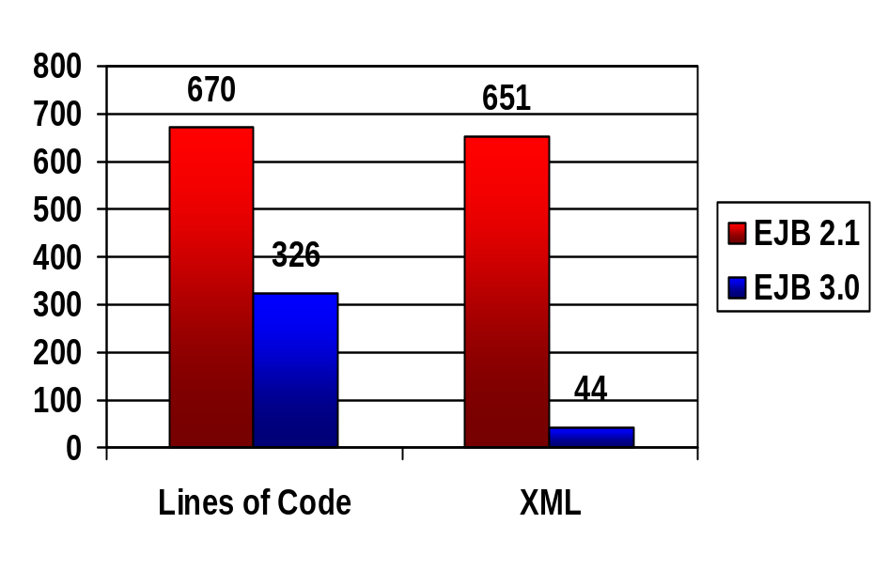
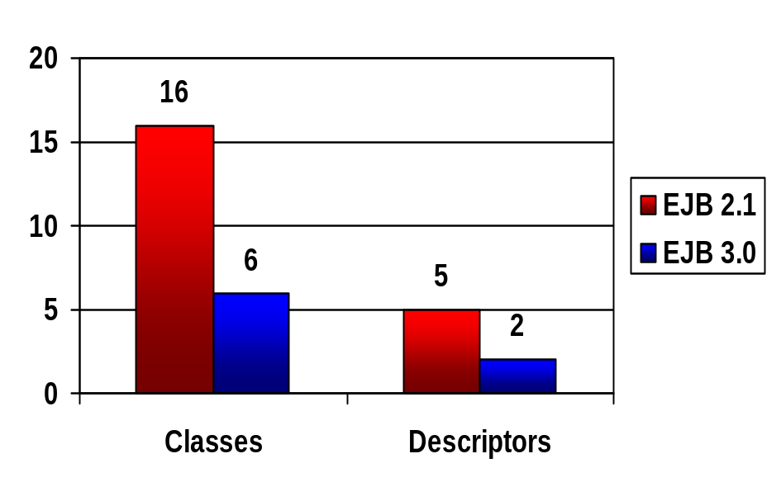
EJB 2.1 Versus 3.0: Simplifying Complexity

Slide 226
Old Way
Application Code (SB, Servlet, etc)
<<I>> EJBObject
<<I>> EJBHome
BeanDTO
<<I>> Bean Home
<<I>> Local Bean
0..*
PK
<<I>> EnterpriseBean
BeanImpl
0..1

Slide 227
New Way
Application Code (SB, Servlet, etc)
EJB3Bean
EntityManager

Slide 228
EntityManager Injection
@Stateless public class CustomerAccessBean {
  private EntityManager em;
  @Inject void setEntityManager(EntityManager em){
  this.em = em;
  }
  public void updateAccountAccess(String cust) {
  Customer c = em.find(Customer.class, cust);
  c.getAccount().setLastAccessTime();
  }
}
Notes:
Access to Entity Manager through injection

Slide 229
Named Queries
@NamedQuery(
name=
“findCustomersByName”,
queryString=
“SELECT c FROM Customer c” +
“WHERE c.name LIKE :custName”
)
@Inject public EntityManager em;
...
List customers =
em.createNamedQuery(“findCustomersByName”)
.setParameter(“custName”, “Smith”)
.listResults();

Slide 230
Flexibility and Performance
Flexibility and performance are not being ignored for ease of development
  O/R Mapping
    Custom type mappings, inheritance …
  EJB QL Enhancements
    Sub queries, bulk operations, group-by …
  Named queries, direct SQL, dynamic queries
  Eager and lazy relationship fetching
  Optimistic locking – version & timestamp

Slide 231
Oracle Support of EJB 3.0
Primary contributor (Mike Keith) on JSR 220 Expert Group
Released EJB 3.0 preview in March 2005
  Includes Entity Test Harness for out-of-container testing
Leading EJB 3.0 Eclipse project
Today Oracle TopLink supports both POJO and EJB 2.1 and 3.0
  Provides seamless path to EJB 3.0
Substantial EJB 3.0 functionality in 10.1.3 production release – 2nd half 2005
  Usable in JDK 1.4 with XML descriptors

Slide 232
Summary
EJB 3.0 significantly improves ease of development
It is real and can be used today
Is the direction for Java persistence
  Based on proven technology
Get a preview and try it out yourself!

